Slide 1
Dell Storage
Федор Павлов
консультант по технологиям хранения

Slide 2
план
Недорогие СХД с понятным способом роста
Сверхпроизводительные ЦОД
Экономия на способе владения СХД
Большие архивы
Телепортация на резервный ЦОД в онлайн режиме
Понимание нагрузки

Slide 3
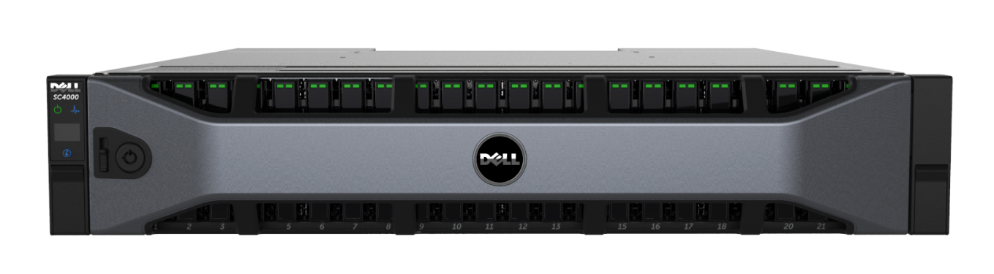
Что будем рассматривать
SC4020
120 дисков
$30k-100k
виртуализация, тиринг, Live Volume

Slide 4
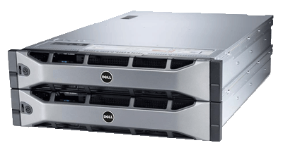
Что будем рассматривать
SC8000 All-Flash
960 дисков
$300k-3m
виртуализация, тиринг, Live Volume, компрессия, Fluid Cache

Slide 5
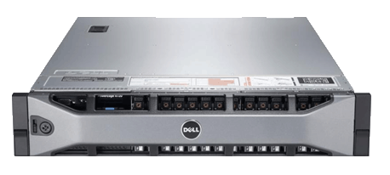
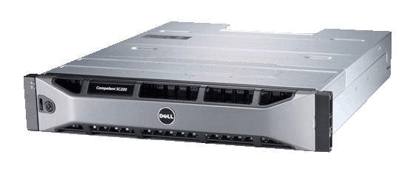
Что будем рассматривать
5 000 000 iops
Shared PCIe SSD cache
Low latency 10/40GB
with RDMA
Private cache network
Dell SC8000
Dell Fluid Cache for SAN
кластер из 3-8 узлов
12.5 TB кэша на чтение/запись

Slide 6
Что будем рассматривать
VM
VM
VM
VM
VM
VM
Виртуальный ЦОД-1
Виртуальный ЦОД-2
Live Volume

Slide 7
план
Недорогие СХД с понятным способом роста
Сверхпроизводительные ЦОД
Экономия на способе владения СХД
Большие архивы
Телепортация на резервный ЦОД в онлайн режиме
Понимание нагрузки

Slide 8
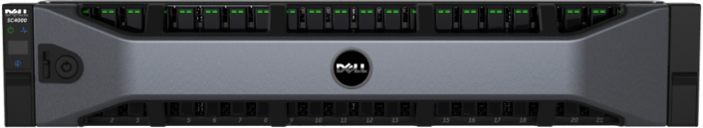
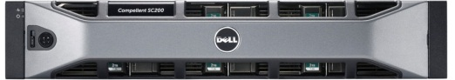
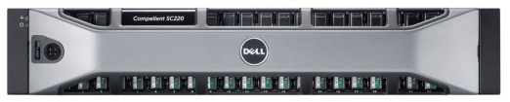
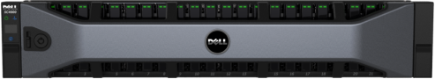
Compellent SC4020
«all-in-one» 2U-модуль SC4020
Комбинация полок SC220/200
24 x 2.5” drives
SC220
SC4020
12 x 3.5” drives
SC200
24 x 2.5” drives + dual controllers
Min 12 drives, Max 24 per SC4020 chassis
Same drive and carrier as SC220
Add expansion enclosures up to 120 drives per system
Типы дисков
2.5” SC4020 and SC220 | SSD | 200GB | SAS, 6 Gb, WISSD
 |  | 400GB | SAS, 6 Gb, WISSD
 |  | 1.6TB | SAS, 6 Gb, RISSD
 | HDD | 300GB | SAS, 6Gb, 15K
 |  | 600GB | SAS, 6Gb, 10K
 |  | 900GB | SAS, 6Gb, 10K
 |  | 1.2TB | SAS, 6Gb, 10K
 |  | 1TB | SAS, 6Gb, 7.2K
SC4020
3.5” SC200 | SSD | 200GB | SAS, 6 Gb, WISSD
 |  | 400GB | SAS, 6 Gb, WISSD
 | HDD | 450GB | SAS, 6Gb, 15K
 |  | 600GB | SAS, 6Gb, 15K
 |  | 2TB | SAS, 6Gb, 7.2K
 |  | 3TB | SAS, 6Gb, 7.2K
 |  | 4TB | SAS, 6Gb, 7.2K
(single SAS chain)
Same options as SC8000, drives ship in separate package

Slide 9
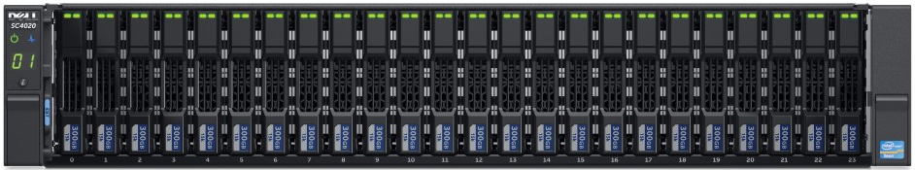
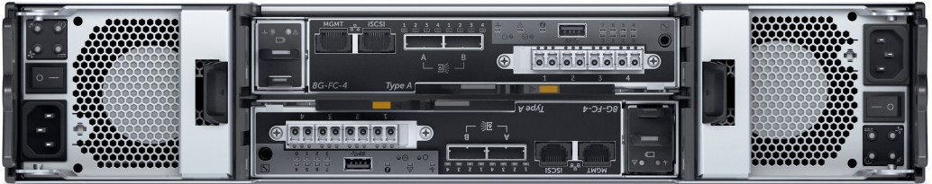
Контроллер SC4020
2U
24 X 2.5” drive slots
Redundant Controllers
Dual Hot-Swap PSUs

Slide 10
Сравнение с SC8000
 | SC8000 Dual Controller | SC4020 Dual Controller
System CPU Complex | 4 CPUs (2 per controller) | 2 CPUs (1 per controller)
 | Intel “Sandy Bridge” Six-Core | Intel “Ivy Bridge” Quad-core
System Memory | 32GB or 128GB | 32GB
Power Supplies | Dual Hot Swap 750W Rated | Dual Hot Swap 580W Rated
Host Connectivity Options | 32-8Gb FC ports 24-16Gb FC ports | 8-8Gb FC ports
 | 10-1GbE iSCSI 10-10GbE iSCSI 10-FCoE ports | 4-10GbE HW iSCSI* ports
Storage Connectivity | 40-6Gb SAS ports (Up to 10 SAS chains) | 4-6Gb SAS ports (Single SAS chain)
Max Raw Storage Capacity | 2 PB | 400 TB+
Max Drive Expansion | 960 SAS HDD/SSD | 120 SAS HDD/SSD
Base Rack Space (24 Drives) | 6U | 2U

Slide 11

Лицензирование SC4020
SC firmware-based bundle and feature licenses
48-drive BASE licenses
24-drive expansions
# of drives:
0 – 48
48-72
72-96
96-120
Each purchasable firmware bundle or feature starts with a value-priced 48-drive BASE license
SCOS Core
Core OS
Dynamic Capacity
Data Instant Replay
Enterprise Manager Foundation/Reporter
Dynamic Controllers
Virtual Ports
Expansion license
Expansion license
Expansion license
24-drive expansion increments = fewer license upgrades to manage
“Perpetual” licensing transfers to new hardware (including from SC4000 to SC8000)
Performance
Data Progression
Fast Track
Expansion license
Expansion license
Expansion license
Remote Data Protection
Remote Instant Replay (Sync/Async Replication)
Expansion license
Expansion license
Expansion license
Live Volume
Expansion license
Expansion license
Expansion license
Host-based
licenses
Single-server licenses
Single-server expansions
Enterprise cap:
Never pay for more than 8 server installations
# of servers:
1
2
3
4
5
6
7
8+
Replay Manager
EM Charge-back (unlimited license)
vCenter Operations Mgr Plug-in (unlimited license)

Slide 12
Сравнение с SC8000
 | SC8000 | SC4020
Data Management & Protection
Compression (Controller Type Dependent) | √ | -
Dynamic Capacity (Core - Thin Provisioning) | √ | √
Data Instant Replay (Core) | √ | √
Virtual Ports (Core - HA) | √ | √
Dynamic Controller (Core - HA) | √ | √
Multi-VLAN Tagging for iSCSI (Core) | √ | √
Data Progression | Optional | Optional (Perf-Bundle)
Remote Instant Replay (Synchronous) | Optional | Optional (DP -Bundle)
Remote Instant Replay (Asynchronous) | Optional | Optional (DP -Bundle)
Live Volume | Optional | Optional [Post RTS]
Self-Encrypting FIPs 140-2 License | Optional | Optional [Post RTS]
Performance/HA
Fast Track | Optional | Optional (Perf-Bundle)
Fluid Cache for SAN | Optional | n/a
Management
Enterprise Manager Foundation/Reporter | √ | √
Enterprise Manager Chargeback | Optional | Optional

Slide 13
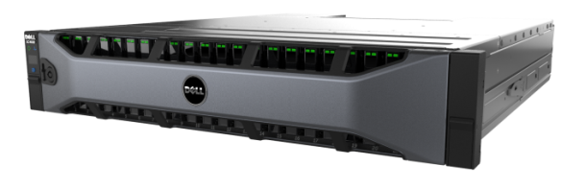
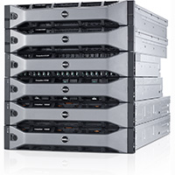
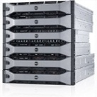


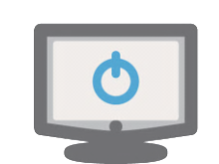
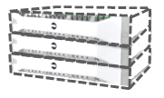
Remote Office
Block and/or file solutions from the same storage pool
SC4020
Sync / Async Replication
FC SAN
NAS
scale-out
SC8000
iSCSI SAN
Tiered Cloud
Disaster Recovery
Live Volume
Secondary Site (2)
Live Volume
Sync / Async Replication
Tertiary Site
Online During
Recovery Ops
Secure cloud
Workload isolation
Server/storage mobility
Secondary Site (1)
Data Progression
Flash optimization
Single-pane Mgmt
Shared firmware
Expansion options
13
NDA

Slide 14
план
Недорогие СХД с понятным способом роста
Сверхпроизводительные ЦОД
Экономия на способе владения СХД
Большие архивы
Телепортация на резервный ЦОД в онлайн режиме
Понимание нагрузки

Slide 15
1.2 - Скорость ради экономии
100%
нагрузка
емкость
100%
объем SSD

Slide 16
1.2 - Скорость ради экономии
Большой объем SSD
MLC - 1.6TB
SLC перед MLC
100%
Логическое разделение чтения и записи
То, что Compellent умеет с 2005 года
нагрузка
емкость
100%
объем SSD

Slide 17
1.2 - Скорость ради экономии
SLC
6 x 400GB SLC = 2400 GB = ~ 900GB writes / day
MLC
6 x 1.6TB MLC = 9600 GB = ~ 5.8 TB usable data
SAS
0…948 x SAS-10K (1.2TB, 900GB, …) или NL-SAS или SAS-15K
Flash Optimized Storage Profile

Slide 18
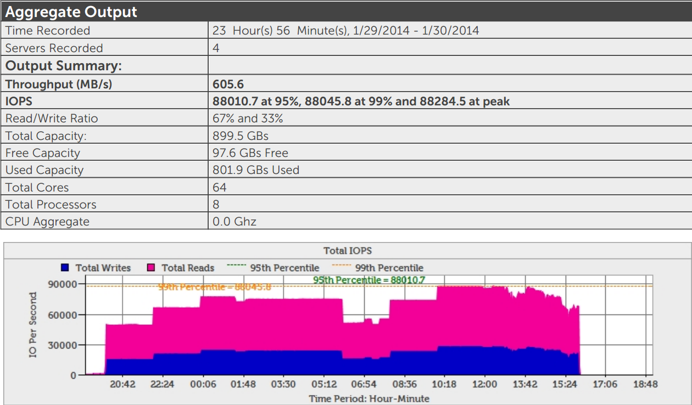
1.2 - Скорость ради экономии

Slide 19
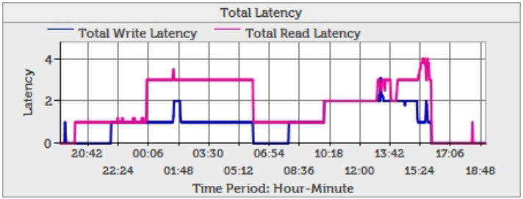
1.2 - Скорость ради экономии

Slide 20
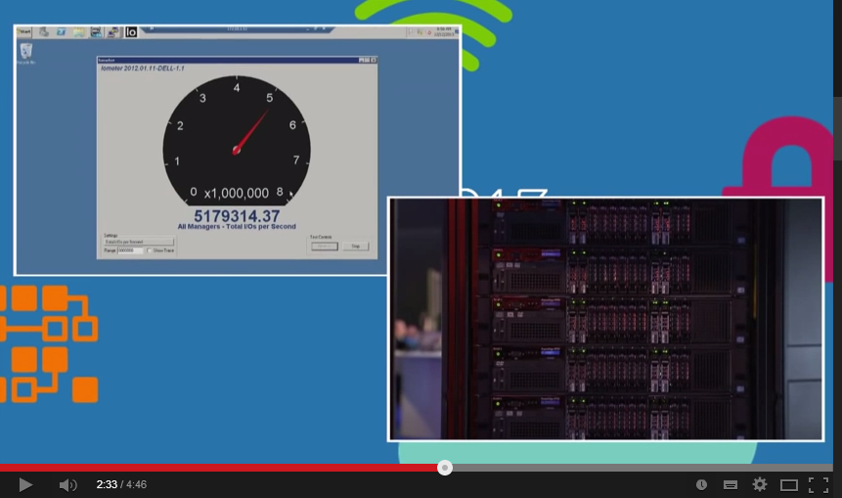
1. Скорость ради прибыли
http://www.youtube.com/watch?v=vD613SLzPQk&list=PLmbFlhPb2qyXyo8cWzgcnhJ5MkDbDUIU0

Slide 21
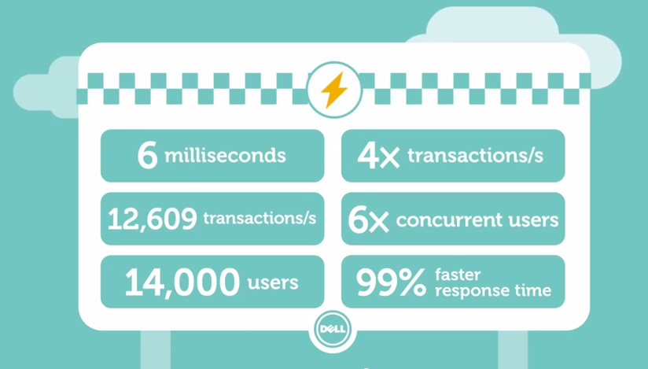
1. Скорость ради прибыли

Slide 22
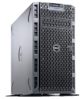


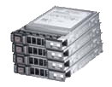
1. Скорость ради прибыли
Dell Fluid Cache
Dell
Cache Contributor Servers*
Cache Client Servers**
1
Install Fluid Cache software
Cache pool
2
Add PCIe SSD Express Flash cache
Private cache network
(10/40 GbE)
3
Configure low-latency network
Storage network (FC or iSCSI)
4
Map volumes to cache pool
Dell Compellent SC 8000 and storage array
*A minimum of 3 validated Dell servers are required to establish the cache pool.
**Cache client servers can be a mix of Dell and other servers that run a supported OS and have an available PCIe slot.
Notes:
Dell Fluid Cache for SAN is a software product.
It is an end-to-end SAN based application acceleration solution.
Architected with a low latency cache pool and intuitive management by Dell Compellent, application performance is highly accelerated and secure, using write-back caching.
This is an example of the configuration using a cluster of 3 Cache contributor servers and 5 Cache Client Servers
Servers
Dell Fluid Cache for SAN at RTS, Dell will validate up to eight total servers per cache pool at RTS
-2 types of servers in a Dell Fluid Cache for SAN deployment:
Cache Contributor Servers, in this example, it is the three servers starting from the left
these will contribute cache to the cache pool
These have applications accessing the cache for compute
Cache Client servers, the remaining 5 servers on the right
These access the cache pool but do not contribute any cache
These are compliant servers and can be Dell or non-Dell servers
Cache Contributor server requirements:
- Contain Dell PCIe SSD Express Flash drives or a Micron P420M card
Contain the Network Interface Card to connect to the 10/40 GbE private Cache Network
Must run one of the supported operating systems
Will be able to run the Dell Fluid Cache for SAN software
Must be one of the validated Dell PowerEdge servers
You can put up to 1.6 TB of cache per server, and you can have up to 12.8 TB of total cache into one cache pool
Cache Client server requirements:
- Contain the Network Interface Card to connect to the 10/40 GbE private Cache Network
Must run one of the supported operating systems
Must be able to run the Dell Fluid Cache for SAN software
**All of the servers in a cache pool will use the total amount of cache from the Cache Contributor servers
Connect all of the servers to the backend Dell Compellent SAN
- connected either via Fibre Channel or iSCSI through the storage network.
Install Dell Fluid Cache software on all of the servers
Next, for all Cache Contributor servers
- In this example we put PCIe SSDs in the three servers on the left
- You can use Dell Express Flash PCIe SSDs or internal Micron P420m cards
Then for all servers in the cache pool, install the specially-designed low latency card for the Private Cache Network connection
Connect via select validated Dell Networking 10/40 GbE switches.
- These switches need to have ports dedicated to the low-latency, private cache network.
At RTS, these are Mellanox 10 and 40GB cards, and there is a Mellanox Mezzanine card for blade use
Now looking at the servers, our Cache Contributor servers comprise the logical cache pool
The cache is used by all 8 servers in the pool able and dramatically accelerate applications of all 8 servers in this cache pool
Lastly, map the volumes to the cache pool.
Data I/O reads and writes are going to Compellent SAN
***************
A good match for Dell Fluid Cache for SAN, are Database and Virtualization workloads
- Oracle on OLTP
- SQL on VM
- VDI with heavy to power users
Can all potentially benefit from Dell Fluid Cache for SAN
Randomized workloads
Dell Fluid Cache for SAN is not going to have much benefit for Sequential Writes

Slide 23
Конфигурация Fluid Cache
ПО Dell Fluid Cache
От 3-х Dell PowerEdge Servers с поддерживаемыми PCIe SSD
От 175GB до 1.6TB кэш-памяти на сервер
validated private cache network interface card (NIC)
10/40 GbE low latency private network
Dell Compellent SC 8000 (маленький Compellent не поддерживается)

Slide 24
Конфигурация Fluid Cache
До 12.8ТБ кэш-памяти на кластер Fluid Cache
До 1.6 ТБ на сервер
Несколько FC-кластеров на 1 Compellent
Можно несколько Compellent на 1 FC-кластер
175GB and 350GB: Micron SLC PCIe SSDs - Dell Express Flash Drives
400GB, 800GB and 1.6TB: Samsung MLC NVME PCIe SSDs
700GB and 1.4TB : Micron MLC PCIe SSDs

Slide 25


Write Cache with High Availability
Server A
Server B
Server C
Application A
Application B
Application C
B
C
A
B
B
B
PCIe SSDs
PCIe SSDs
PCIe SSDs
Host Cache
Write data
Replicate
Complete write
SAN
Flush data
A
B
B
C
Free replica
Notes:
How we protect data, making it highly available with write back caching
- This scenario shows a Dell Fluid Cache for SAN architecture – using 3 Servers, each server in this example has PCIe SSDs
Each server is running applications
Fluid Cache for SAN maintains the application data in the cache pool
Application on server B, the write comes in.
Before Application B gets the acknowledgement, Fluid Cache makes a block replication into server C.
Once that replication is done in server C, the acknowledgement is sent, so the acknowledgement is very fast.
The data does not have to travel to the SAN and then wait for the SAN to make the acknowledgement, so the acknowledgement from the server level via the cache is very fast.
Dell Fluid Cache for SAN will flush the data to the SAN in a few moments
Server C data replication is removed because the most up to date data is now safe in the Dell Compellent SAN.

Slide 26


Write Cache with High Availability
PCIe SSD failure
Server A
Server B
Server C
Application A
Application B
Application C
A
B
B
C
B
B
B
C
PCIe SSDs
PCIe SSDs
PCIe SSDs
Host Cache
PCIe SSD fails
Re replicate B
SAN
Re read C
A
B
B
C
Flush data
C
Free replica
Notes:
PCIe SSD failure:
The PCIe SSD in Server C, where the replication data B is located, fails
- Immediately Dell Fluid Cache for SAN recognizes that the PCIe SSD in Server C has failed, and makes a copy of the replication B data into Server A
Dell Fluid Cache for SAN also recognizes that data C was on the PCIe in server C. Immediately, the data C is pulled up from the Compellent SAN and placed onto Server B in the Cache pool.
This slide illustrates that because of write-back caching technology, the data in the cache layer is safe!
All of the customers ask how the data is made safe.
- Make sure the customers understand this slide and how we make the data is safe.

Slide 27

Write Cache with High Availability
Server node failure
Server A
Server B
Server C
Application A
Application B
Application C
A
B
B
C
B
B
B
C
PCIe SSDs
PCIe SSDs
PCIe SSDs
Host Cache
Node fails
Re replicate B
SAN
Re read C
A
B
B
C
Flush data
C
Free replica
Notes:
Server C node failure
Server C, where the replication data B as well as Data C is located, fails
- Immediately Dell Fluid Cache for SAN recognizes that Server C has failed, and makes a copy of the replication B data into Server A
Dell Fluid Cache for SAN also recognizes that data C was on Server C. Immediately, data C is pulled up from the Compellent SAN and placed onto Server B in the Cache pool.
This slide illustrates that because of write-back caching technology, the data in the cache layer is safe!
All of the customers ask how the data is made safe.
- Make sure the customers understand this slide and how we make the data is safe.

Slide 28
Snapshot with Dell Compellent SAN
Server A
Server B
Server C
Application A
Application B
Application C
A
B
B
C
B
B
B
PCIe SSDs
PCIe SSDs
PCIe SSDs
Host Cache
Flush Request
SAN
Snapshot Request
A
B
B
C
A
B
C
C
Snapshot
Notes:
You can create a snapshot in Dell Compellent.
The request for the Snapshot comes from Dell Compellent
We have the data in the cache pool.
The integration in the SAN is important for Dell Fluid Cache for SAN. Compellent needs to know there is a cache pool on the top.
- It will flush the cache in pass through mode until the snapshot has completed.

Slide 29
OLTP running on SQL on VM:
3 node architecture Dell lab test
Dell R720
Dell R720
Dell R720
PCIe SSDs*
PCIe SSDs*
Shared PCIe SSD cache
Low latency 10GBe
with RDMA
Private cache network
Storage network
(Fibre Channel or iSCSI)
Dell Compellent SC 8000 and storage array
Storage Area Network (SAN)
Dell Storage Center Minimum Version 6.5
*Of the three servers establishing the cache pool, at least two servers must have at least one PCIe SSD each. In this example, the first and third servers have four PCIe SSD card each.
Notes:
So lets understand what’s running behind these performance stats of the 3 node OLTP cluster:
In this instance Dell Fluid Cache for SAN is running Microsoft SQL server running Microsoft® SQL Server® database on ESX 5.5
3 R720s as the Cache Cluster
All three have Dell Fluid Cache for SAN software installed
Two of these servers have The first two PowerEdge R720 servers both have 4 x 350GB Express Flash PCIe SSDs 1400 GB of cache, for a total of 2800 GB of Cache in the Shared PCIe SSD cache pool acting as a cache device
all these three servers are running services needed by Dell Fluid Cache for SAN
All three servers are sharing the cache provided by the two servers.
Compellent SAN is Connected via Fibre Channel (Brocade® 6510) switches
Benchmarks were conducted in Dell Labs using Benchmark Factory tool
For OLTP simulation, TPC-C benchmarks were used.
Average response Time (ART) ,
though there is no stated industry standard, an typical ART OLTP industry-wide used measurement is between 1-2 seconds
so any tests with a workload producing greater than1 second was not considered in our results
With Fluid Cache although ART was reduced 86% (without ART was 143 milliseconds, with DFCFS the ART was 20 milliseconds)
**To note, the user load with Dell Fluid Cache for SAN of 6900 Concurrent Users in this Dell Lab test was limited because of other limiting factors outside the control of Dell Fluid Cache for SAN

Slide 30
OLTP running on SQL on VM: Performance
3 node architecture Dell lab test
Average Response Time in milliseconds
Cost per concurrent user
in USD
86% ART reduction
More users are able to access the existing hardware providing a lower cost per user
*Based on Dell Lab testing of a 3-node OLTP cluster running Microsoft® SQL Server® database on VMware® software with Dell Fluid Cache for SAN vs. the same configuration without Dell Fluid Cache for SAN, where the configuration with Dell Fluid Cache for SAN resulted in 6900 concurrent users at one second and costs $252,063 USD, or $36.53 USD per user, at the one second measurement, and the configuration without Dell Fluid Cache for SAN resulted in 2700 concurrent users at one second and costs $225,965 USD, or $83.69 USD per user, at the one second measurement. List prices dated March 2014.
Notes:
With Dell Fluid cache for SAN installed on the same hardware stack, while the total solution cost is slightly higher
DFCFS software
Express Flash
NIC cards
The cost per user is lower as they were able to accommodate more concurrent users on the same hardware, and even at a lower average response time
A Dell lab test of Dell Fluid Cache for SAN on a 3 node OLTP cluster running Microsoft® SQL Server® database on VMware® software found:
More concurrent users (6900 Concurrent Users vs. 2700 Concurrent Users) on the same hardware stack
Resulting in a lower cost per user, by 56%
Average response time (ART) was reduced 86% (without ART was 143 milliseconds, with ART was 20 milliseconds)
Many SMB customers run OLTP with SQL on VM and cost per user is very important.
Our Dell Lab tests showed that DFCFS can deliver better performance and a lower cost per user of an OLTP cluster running Microsoft® SQL Server® database on VMware® with Dell Fluid Cache for SAN enabled on the same hardware stack

Slide 31
OLTP running on SQL on VM: Performance
3 node architecture Dell lab test
Maximum number of Concurrent Users
per second
Dell lab tests resulted in a maximum number of concurrent users per second increase of 2.5x compared to the
same hardware environment without Dell Fluid Cache for SAN
Notes:
- A Dell lab test of a 3 node OLTP cluster running Microsoft® SQL Server® database on VMware® software without Dell Fluid Cache for SAN resulted in 2700 Concurrent Users.
A Dell lab test of the same 3 node OLTP cluster running Microsoft® SQL Server® database on VMware® software WITH Dell Fluid Cache for SAN resulted in 6900 Concurrent Users.
support for 2.5 times more Concurrent Users, than the same hardware tested without Dell Fluid Cache for SAN.

Slide 32
OLTP running on SQL on VM: Performance
3 node architecture Dell lab test
Maximum number of
Transactions Per Second (TPS)
Dell lab tests resulted in a maximum number of transactions per second increase of 2.5x compared
to the same hardware environment without Dell Fluid Cache for SAN
Notes:
OLTP with SQL on VM allowed 2.5x more transactions per second – jumping from X to Y
Same hardware environment with Dell Fluid Cache for SAN added to the hardware stack
A Dell lab test of a 3 node OLTP cluster running Microsoft® SQL Server® database on VMware® software without Dell Fluid Cache for SAN resulted in 3435 Transactions Per Second (TPS)
A Dell lab test of the same 3 node OLTP cluster running Microsoft® SQL Server® database on VMware® software WITH Dell Fluid Cache for SAN resulted in 8893Transactions Per Second (TPS)
A Dell lab test of Dell Fluid Cache for SAN on a 3 node OLTP cluster running Microsoft® SQL Server® database on VMware® software saw 2.5 times more Transactions Per Second (TPS), than the same hardware tested without Dell Fluid Cache for SAN.

Slide 33
OLTP running on Oracle
3 node architecture Dell lab test
Dell R820
Dell R620
Dell R820
PCIe SSDs*
PCIe SSDs*
Shared PCIe SSD cache
Low latency 10GBe
with RDMA
Private cache network
Storage network
(Fibre Channel or iSCSI)
Dell Compellent SC 8000 and storage array
Storage Area Network (SAN)
Dell Storage Center Minimum Version 6.5
*Of the three servers establishing the cache pool, at least two servers must have at least one PCIe SSD each. In this example, the first and third servers have four PCIe SSD card each.
Notes:
In this instance Dell Fluid Cache for SAN is running Oracle on OLTP
The Dell Fluid Cache for SAN cluster is deployed with Dell Fluid Cache software on two PowerEdge R820 systems, and one PowerEdge R620 system which is added as a management server for Fluid Cache.
- All three servers have Dell Fluid Cache for SAN software installed
Two of these servers have cache, and the third server is running other services needed by Dell Fluid Cache for SAN
The two PowerEdge R820 systems act as cache servers by hosting 2 x 350GB Express Flash PCIe SSDs in each server
A total of 700GB per server, and 1400 GB of Cache in the pool
All three servers are sharing the 1400 GB of cache provided by the two R820 servers.
Connected via Fibre Channel (Brocade 6510) 16Gbps switches
Benchmarks were conducted in Dell Labs using Benchmark Factory tool
For OLTP simulation, TPC-C benchmarks were used.
Average response Time (ART) ,
though there is no stated industry standard, an typical ART OLTP industry-wide used measurement is between 1-2 seconds
so any tests with a workload producing greater than1 second was not considered in our results
With Fluid Cache although ART was reduced 97% (without ART was 1500 milliseconds , with DFCFS the ART was 46 milliseconds)
**To note, Dell Fluid Cache for SAN results in this Dell Lab test were limited because of other limiting factors outside the control of Dell Fluid Cache for SAN

Slide 34
OLTP running on Oracle: Performance
3 node architecture Dell lab test
Average Response Time
(in milliseconds)
Cost per concurrent user
in USD
97% ART reduction
Dell Fluid Cache for SAN can provide cost per user reductions with performance gains
*Based on Dell Lab testing of a 3 node OLTP cluster on an Oracle® database with Dell Fluid Cache for SAN vs. the same configuration without Dell Fluid Cache for SAN, where the configuration with Dell Fluid Cache for SAN resulted in 1900 concurrent users at one second and costs $360,191 USD, or $189.57 USD per user, at the one second measurement, and the configuration without Dell Fluid Cache for SAN resulted in 500 concurrent users at one second and costs $331,696 USD, or $663.39 USD per user, at the one second measurement. List prices dated March 2014.
Notes:
We saw similar results with a 3 Node Dell Lab test of OLTP running on Oracle.
With Dell Fluid cache for SAN installed on the same hardware stack, while the total solution cost is slightly higher
DFCFS software
Express Flash
NIC cards
The cost per user decreased by 71% since more concurrent users were able to able to access the same hardware stack
Additionally, average response time (ART) reduced 97%
Even for large customers costs are important.
- This Dell Lab test showed that DFCFS can deliver better performance for OLTP on Oracle and at lower cost per user with Dell Fluid Cache for SAN enabled on a hardware stack

Slide 35
OLTP running on Oracle: Performance
3 node architecture Dell lab test
Maximum number of Concurrent Users
per second
Dell lab tests resulted in a
maximum number of concurrent users per second increase of 4x compared to the same hardware environment without Dell Fluid Cache for SAN
Notes:
OLTP with Oracle 3 Node Architecture Dell Lab test allowed 4x more concurrent users per second – jumping from 500 Concurrent Users to 1900 Concurrent Users
- 4 times more Concurrent Users with Dell Fluid Cache for SAN, than the same hardware stack tested without Dell Fluid Cache for SAN.

Slide 36
OLTP running on Oracle: Performance
3 node architecture Dell lab test
Maximum number of
Transactions Per Second (TPS)
Dell lab tests resulted in a
maximum number of transactions per second increase of 4.4x
compared to the same hardware environment without Dell Fluid Cache for SAN
Notes:
OLTP with Oracle allowed 4.4x more transactions per second (TPS) – jumping from 449 Transactions Per Second to 1979 Transactions Per Second (TPS),
- 3 node OLTP cluster running on an Oracle® database with the Same hardware environment with Dell Fluid Cache for SAN added to the hardware stack

Slide 37

OLTP on Oracle
8 Node Architecture Dell Lab test
Dell R720
Dell R720
Dell R720
Dell R720
Dell R720
Dell R720
Dell R720
Dell R720
Cache pool
Private cache network
(10/40 GbE)
Storage network (FC or iSCSI)
Dell Compellent SC 8000 and storage array
*In this example, the eight servers comprising the cache pool each have two PCIe SSD each.
Notes:
In this instance Dell Fluid Cache for SAN is running Oracle on OLTP
Eight R720s have Express Flash installed
All eight servers are sharing the cache provided by the eight servers
Maximum nodes shown with 8 Servers
Cache is 700 GB per server

Slide 38
OLTP running on Oracle: Performance
8 node architecture Dell lab test
Average Response Time (ART)
in milliseconds
Dell lab tests resulted in a average response time reduction by 99.3% compared to the same hardware environment without Dell Fluid Cache for SAN
Notes:
An 8 node architecture Dell Lab test hardware configuration of simulated OLTP on Oracle Database Performance yielded the following results:
Without Dell Fluid Cache for SAN:
876 millisecond Average Response Time (ART)
The same hardware stack with Dell Fluid Cache for SAN:
6 millisecond Average Response Time (ART)
Average Response Time (ART):99.3% reduction

Slide 39
OLTP running on Oracle: Performance
8 node architecture Dell lab test
Maximum number of Concurrent Users
per second
Dell lab tests resulted in a
maximum number of concurrent users per second increase of 6x compared to the same hardware environment without Dell Fluid Cache for SAN
Notes:
An 8 node architecture Dell Lab test hardware configuration of simulated OLTP on Oracle Database Performance yielded the following results:
Without Dell Fluid Cache for SAN:
2200 Concurrent Users (CU)
The same hardware stack with Dell Fluid Cache for SAN:
14000 Concurrent Users (CU)
Comparing the performance results of this hardware stack with and without Dell Fluid Cache for SAN:
Concurrent Users (CU): 6 times increase Cache for SAN added to the hardware stack

Slide 40
OLTP running on Oracle: Performance
8 node architecture Dell lab test
Maximum number of
Transactions Per Second (TPS)
Dell lab tests resulted in a
maximum number of transactions per second increase of 4x compared to the same hardware environment without Dell Fluid Cache for SAN
Notes:
An 8 node architecture Dell Lab test hardware configuration of simulated OLTP on Oracle Database Performance yielded the following results:
Without Dell Fluid Cache for SAN:
3260 Transactions Per Second (TPS)
The same hardware stack with Dell Fluid Cache for SAN:
12609 Transactions Per Second (TPS)
Comparing the performance results of this hardware stack with and without Dell Fluid Cache for SAN:
Transactions Per Second (TPS) saw a 3.9x Increase

Slide 41
Dell lab tests of Oracle OLTP workloads:
Scale up to meet your business demand
Oracle OLTP
8 Node architecture
Oracle OLTP
3 Node architecture
With and without
Dell Fluid Cache for SAN
Transactions Per Second (TPS):
3.9x Increase
(3260 to 12609 TPS)
Average Response Time (ART):
99.2% reduction
(876 ms to 6 ms)
Concurrent Users (CU):
6.4 times increase
(2,200 to 14,000 concurrent users)
With and without
Dell Fluid Cache for SAN
Transactions Per Second (TPS):
3.4x Increase
(449 to 1979 TPS)
Average Response Time (ART):
97% reduction
(1500 ms to 46 ms)
Concurrent Users (CU):
2.8 times increase
(500 to 1900 concurrent users)
Notes:
Look at the concurrent users with and without Dell Fluid Cache for SAN
At 3 nodes it jumped from 500 to 1900 users, in our Dell Lab test.
At 8 nodes, concurrent users went from 2,200 to 14,000!
Your customer can fit anywhere in between these – maybe they would benefit from 4,5, or even 6 node deployment to begin with. This would leave room for future business growth by adding more cache in the future or more server nodes in the future – or more of both later on!
For Oracle OLTP customers could see great performance gains not only in concurrent users, but also more transactions per second (TPS) as well as reductions in Average Response Time. (TPS)
Because of the solution’s flexibility for deployment, depending upon customer’s requirements, Fluid Cache for SAN can be tailored crafted to best suite their requirements.
Keeping this in mind, there are various parameters which can affects performance in a Fluid Cache based solution:
Number of Cache contributor nodes
Number of client (server) nodes
Amount of cache in pool
The speed of the Private cache network
SAN connectivity (Fibre Channel or ISCSI) speed to storage
Storage arrays (rotating , hybrid, or AFA)
Connectivity between servers e.g. Oracle RAC connectivity speed
And of course the application workload: random or sequential; reads or write
The flexibility of deployment is one of the greatest features of Dell Fluid Cache for SAN
All performance will differ and vary depending on deployment and applications and workloads

Slide 42
план
Недорогие СХД с понятным способом роста
Сверхпроизводительные ЦОД
Экономия на способе владения СХД
Большие архивы
Телепортация на резервный ЦОД в онлайн режиме
Понимание нагрузки

Slide 43
1.3 – Новая Модель Владения СХД
$
деньги
3
1
$
$
4
2
$
$
время

Slide 44
1.3 – Новая Модель Владения СХД
«Вечные» лицензии
дешевые переходы с поколения на поколение
можно доставлять карты (в т.ч. SAS) в контроллеры –> дольше работать
ИТОГО: классическая система хранения с единой поддержкой и заводской сборкой, которая имеет модель владения схожую с софтверной СХД

Slide 45
план
Недорогие СХД с понятным способом роста
Сверхпроизводительные ЦОД
Экономия на способе владения СХД
Большие архивы
Телепортация на резервный ЦОД в онлайн режиме
Понимание нагрузки

Slide 46
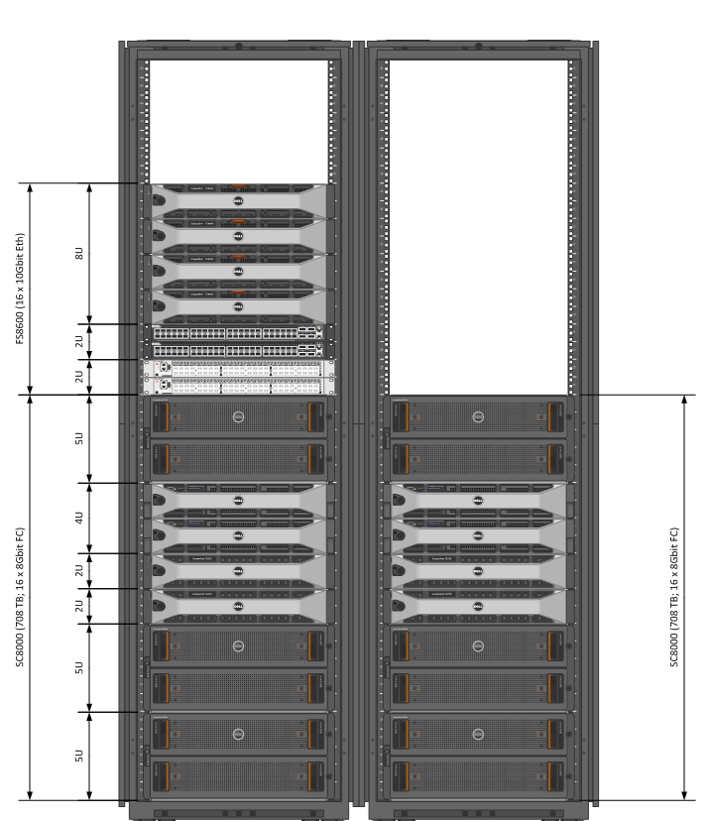
Большие емкости
4 контроллера SC8000
8 узлов FS8600
Параллельная файловая система Fluid FS
2072 TB raw в 10 полка
6 x SC280 по 84 x 4TB
4 x SC220 по 24 x SAS-10K
Одна файловая система, одна точка монтирования
1.5 стойки

Slide 47
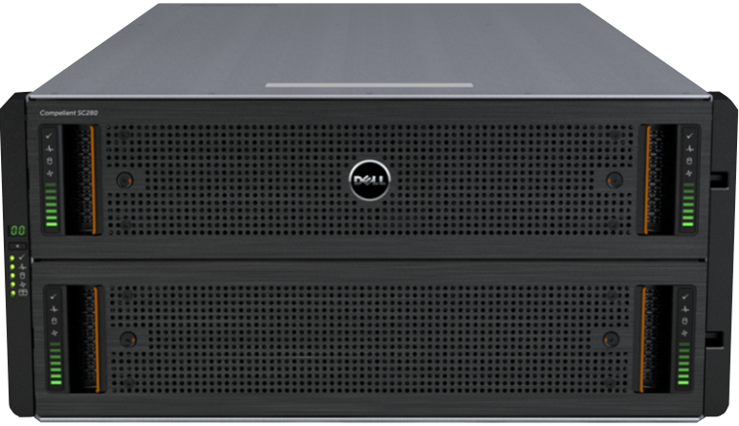
Полка SC280
336TB
5U
84 диска 4TБ
Шаг 42 диска
Только NL-SAS 4ТБ
2 полки на 1 шину
1 SAS карта = 2 шины
Notes:
The SC280 dense enclosure provides extreme density in a small footprint and has the best rack density of any major storage solution (EMC, HP, Hitachi, Netapp). It supports 84 drives in a 5U footprint and helps customers maximize floor space in their data center. The target is large enterprise and government environments that need bulk storage in a small footprint.
The SC280 requires SC6.4 and has 2 drawers, each one holds 42 drives that can be hot swapped. It has 2 Power supplies and 5 fans that also can be hot swapped. Two configurations will be offered initially, either with half populated with 42 drives or fully populated with 84 drives. Supported drives are 4TB, 7200 RPM drives.
Up to 2 SC280 enclosures can be included per single loop which gives customers 168 drives on the loop. Controller support will be SC8000 at RTS and SC40 soon afterwards. As for Compatibility, 2 SC280 enclosures can be on the same loop but customers cannot mix with SC200, SC220 or Xyratex 6 Gb SAS enclosures on the same loop. They need to go on a separate loop which can be on the same HBA.
The maximum number of SC280 enclosures per Storage Center system is 5 which gives customers 400 active drives or 1.6PB raw capacity.

Slide 48
план
Недорогие СХД с понятным способом роста
Сверхпроизводительные ЦОД
Экономия на способе владения СХД
Большие архивы
Телепортация на резервный ЦОД в онлайн режиме
Понимание нагрузки

Slide 49
1.4 – Телепортация виртуального ЦОД
DA = проактивное предотвращение аварии
DR = аварийное восстановление
Live Volume 6.5 + vMotion
Репликация + SRM
DR-HA = аварийный авторестарт
точка аварии
Live Volume 6.6 + VMw HA
время

Slide 50
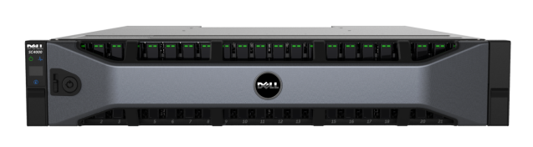
1.4 – Телепортация виртуального ЦОД
VM
VM
VM
ESX-1
ESX-2
read + write
no access
LV
LV
replication
proxy access

Slide 51
1.4 – Телепортация виртуального ЦОД
VM
VM
vmotion
VM
VM
ESX-1
ESX-2
read + write
no access
LV
LV
replication
proxy access

Slide 52
1.4 – Телепортация виртуального ЦОД
VM
VM
VM
ESX-1
ESX-2
read + write
read + write
LV
LV
replication
LV
proxy access

Slide 53
1.4 – Телепортация виртуального ЦОД
VM
IP L-2
VM
VM
ESX-1
ESX-2
read + write
read + write
LV
LV
replication
LV
proxy access

Slide 54
1.4 – Телепортация виртуального ЦОД
VM
IP L-2
VM
vmotion
VM
VM
ESX-1
ESX-2
read + write
read + write
LV
LV
replication
LV
proxy access

Slide 55
1.4 – Телепортация виртуального ЦОД
IP L-2
VM
vmotion
VM
VM
ESX-1
ESX-2
read + write
read + write
LV
LV
replication
LV
proxy access

Slide 56
1.4 – Телепортация виртуального ЦОД
IP L-2
VM
vmotion
VM
VM
ESX-1
ESX-2
read + write
read + write
LV
LV
LV
replication
autoswap
proxy access

Slide 57

Scale-Out Data Center
Ферма виртуализации x86
(скажем, VMware)

Slide 58
Scale-Out Data Center
Ферма виртуализации x86
(скажем, VMware)
Масштабируем количеством (горизонтально)
Виртуальная машина не может исполняться на двух узлах одновременно

Slide 59
Scale-Out Data Center
Ферма виртуализации x86
(скажем, VMware)
Масштабируем количеством (горизонтально)
Виртуальная машина не может исполняться на двух узлах одновременно
Но может перемещаться между ними без остановки работы
VM
VM

Slide 60

Scale-Out Data Center
Ферма виртуализации x86
(скажем, VMware)
SAN

Slide 61
Scale-Out Data Center
Ферма виртуализации x86
(скажем, VMware)
Ферма хранения x86
(Dell Compellent)
SAN

Slide 62
Scale-Out Data Center
Ферма виртуализации x86
(скажем, VMware)
Ферма хранения x86
(Dell Compellent)
SAN

Slide 63
Scale-Out Data Center
Ферма виртуализации x86
(скажем, VMware)
Ферма хранения x86
(Dell Compellent)
Масштабируем количеством (горизонтально)
Виртуальный том не может обрабатываться двумя узлами одновременно
Но может перемещаться между ними без остановки работы
SAN

Slide 64
Scale-Out Data Center
Ферма виртуализации x86
(скажем, VMware)
Ферма хранения x86
(Dell Compellent)
SAN
SAN

Slide 65
план
Недорогие СХД с понятным способом роста
Сверхпроизводительные ЦОД
Экономия на способе владения СХД
Большие архивы
Телепортация на резервный ЦОД в онлайн режиме
Понимание нагрузки

Slide 66
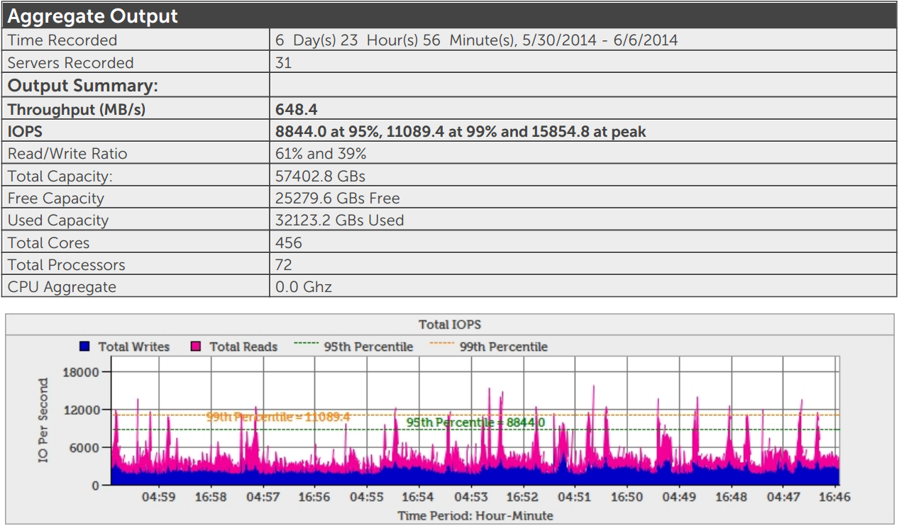
Понимание заказчика
Google -> Dell DPACK

